Slide 1
Azure Management Group Hierarchy Design
Policy Inheritance and Department-Level Governance
Team-T155
Technology: Microsoft Azure
Project ID: 24CC3046-P053

Slide 2
Problem Statement & Objectives
Problem Statement
Managing multiple departments in Azure can become difficult when subscriptions and resources grow. Without a proper management hierarchy, applying and maintaining governance policies separately for each department can lead to duplication and inconsistent configurations.
Objectives
Design a centralized Azure Management Group hierarchy for four departments.
Organize IT, Finance, HR, and Operations under one organization.
Apply governance policies at the organization level.
Demonstrate policy inheritance to child departments.
Apply an additional department-specific policy to IT.
Reduce policy duplication and improve centralized governance.

Slide 3
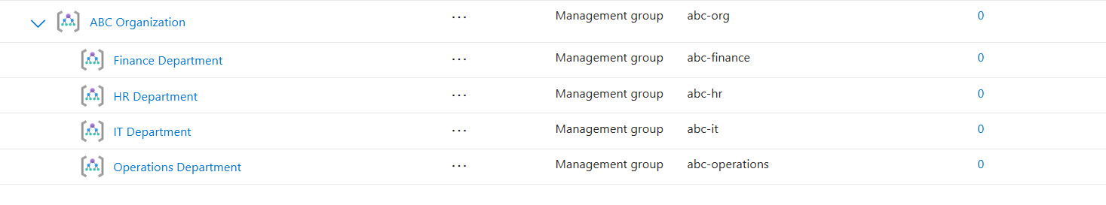
Azure Management Group Hierarchy
Hierarchy Components
ABC Organization – Parent management group
IT Department – Technology-related governance
Finance Department – Financial resources and policies
HR Department – Human-resource related governance
Operations Department – Operational resources and policies

Slide 4
Organization-Level Policy Assignment
Policy: Allowed Locations
Policy Name:
ABC Organization - Allowed Locations
Scope:
ABC Organization (abc-org)
Allowed Location:Central India
Effect:Deny
Purpose
Restricts resource deployment to approved Azure regions.
Prevents deployment in unauthorized locations.
Provides centralized governance at the organization level.
The policy can be inherited by child departments.

Slide 5
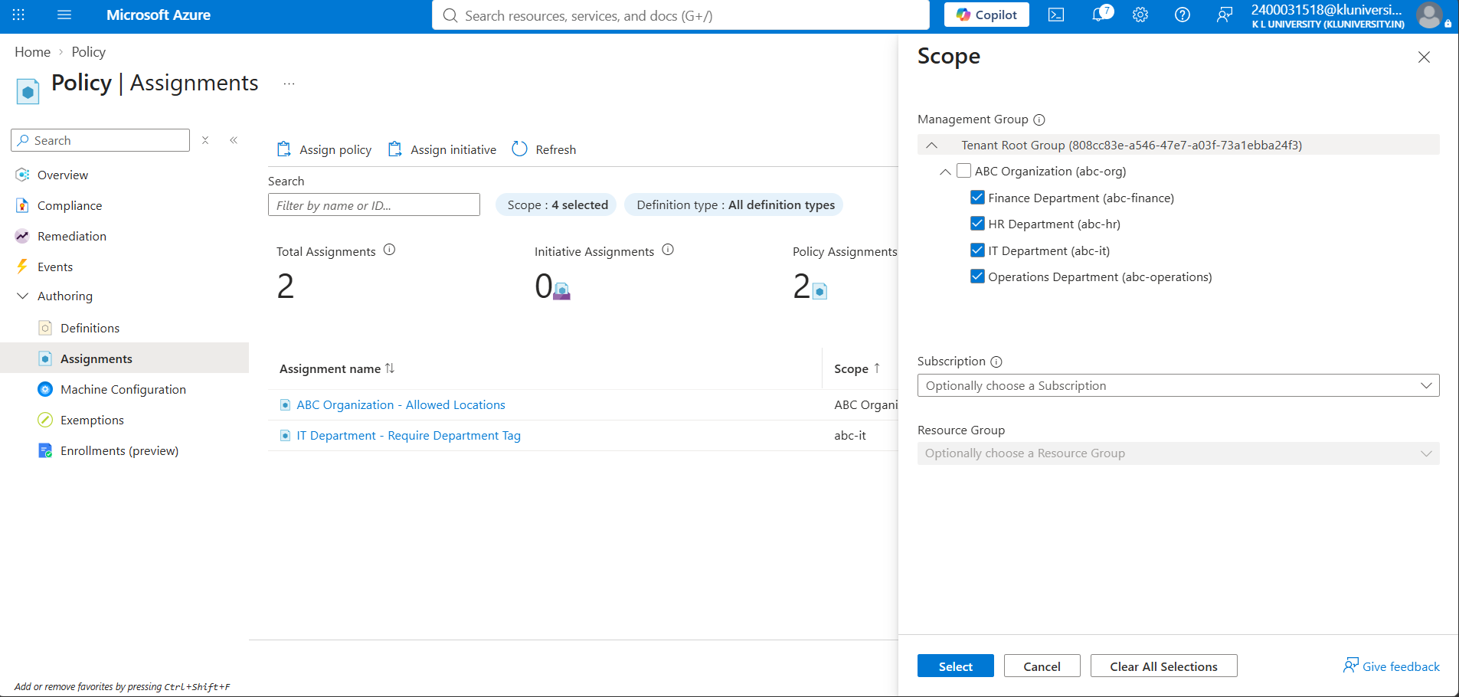
Policy Inheritance
Policy Inheritance Across Departments
Parent Policy:
Policy: Allowed Locations
Scope: ABC Organization
Allowed Region: Central India
Effect: Deny
Inherited by:
IT Department
Finance Department
HR Department
Operations Department

Slide 6
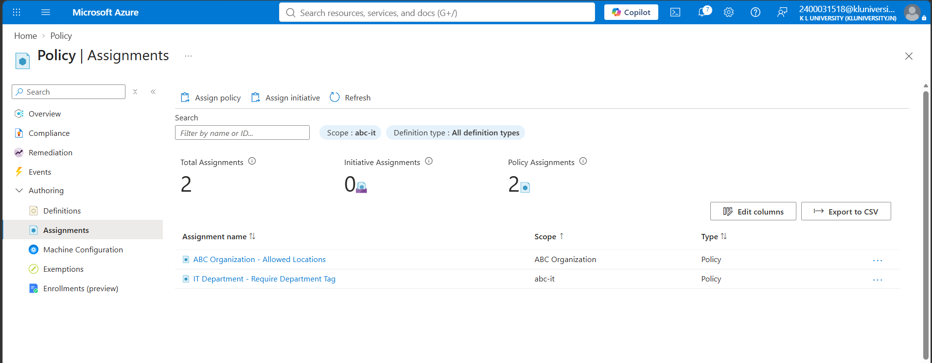
Department-Level Governance
IT Department-Specific Governance
Policy: Require a tag on resources
Scope: IT Department (abc-it)
Required Tag:
Department
Why?
Adds department-specific governance.
IT receives the organization-level policy plus its own policy.
Demonstrates multiple effective policies at different hierarchy levels

Slide 7
Conclusion & Future Scope
Conclusion
Successfully designed a four-department Azure Management Group hierarchy.
Implemented centralized governance using Azure Policy.
Demonstrated policy inheritance from the parent management group.
Implemented department-specific governance for IT.
Reduced the need for duplicate policy assignments.
Future Scope
Add subscriptions under the appropriate department management groups.
Implement department-specific policies for Finance, HR, and Operations.
Monitor compliance using the Azure Policy Compliance dashboard.
Add more security and cost-governance policies.
Automate governance using Azure Policy initiatives

